Slide 1

Cucumber with Selenium-Part 2

Slide 2
Introduction
Cucumber is a testing approach which supports Behavior Driven Development (BDD). It explains the behavior of the application in a simple English text using Gherkin language.
Cucumber tool is based on the Behavior Driven Development framework that acts as the bridge.

Slide 3
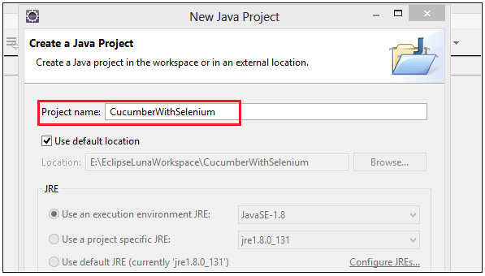
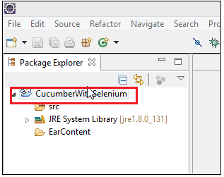
Procedure to implement cucumber with selenium
Example 1:-Print text in the console.
Step 1) Create Java project with the name "CucumberWithSelenium" in eclipse as shown in the below screenshot.

Slide 4
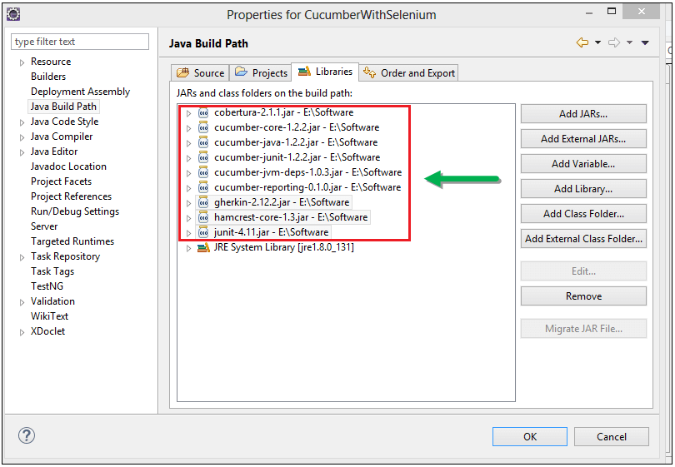
Step 2) Adding Jar files in the project.
Right Click on the Project > Select Properties > Go to Java Build Path. Add all the downloaded libraries

Slide 5
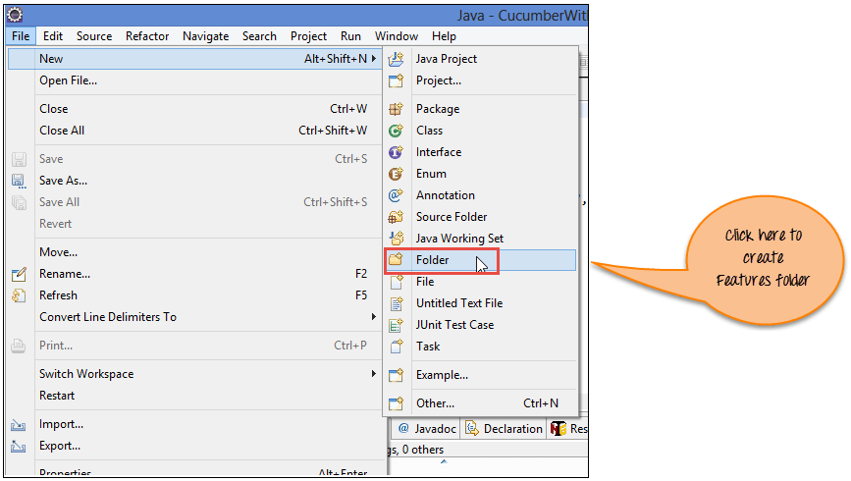
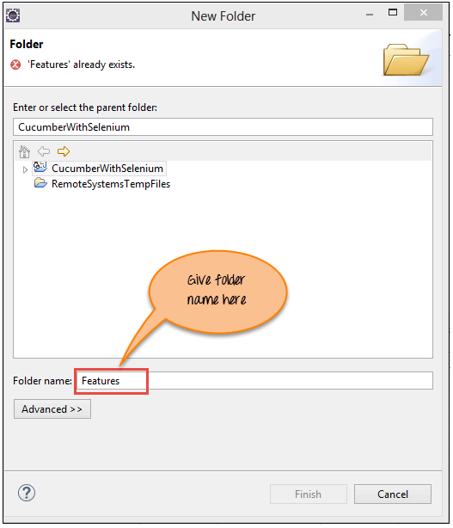
Step 3) Creating feature file
For creating feature file first create features folder as shown below screenshot.
Now Enter Folder name 'Features' and
click on 'Finish' Button.

Slide 6
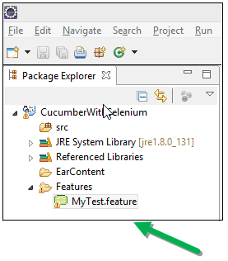
Now create feature file in the 'Features' folder with the name of
"MyTest.feature“
Step 4) Write scenarios.
Below lines are written in 'MyTest.feature' file
using the Gherkin language as shown below:
Code Explanation of 'MyTest.feature' file
Line 1) In this line we write business functionality.
Line 2) In this line we write a scenario to test.
Line 3) In this line we define the precondition.
Line 4) In this line we define the action we need to perform.
Line 5) In this line we define the expected outcome or result.
Feature: Reset functionality on login page of Application
Scenario: Verification of Reset button
Given Open the Firefox and launch the application
When Enter the Username and Password
Then Reset the credential

Slide 7
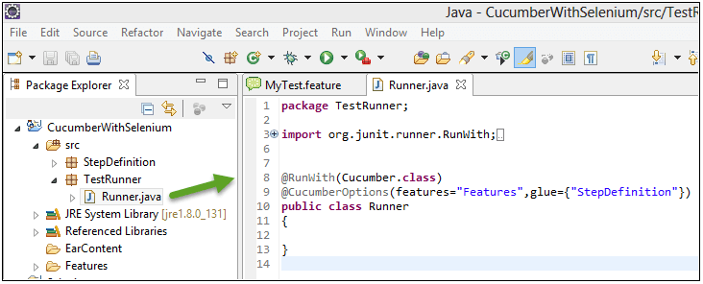
Step 5) Writing selenium testrunner script.
Here create 'TestRunner' package and then 'Runner.java' class file under it.
@RunWith() annotation tells about the test runner class to start executing tests.
@CucmberOptions() annotation is used to set some properties for our cucumber test like feature file, step definition etc.

Slide 8
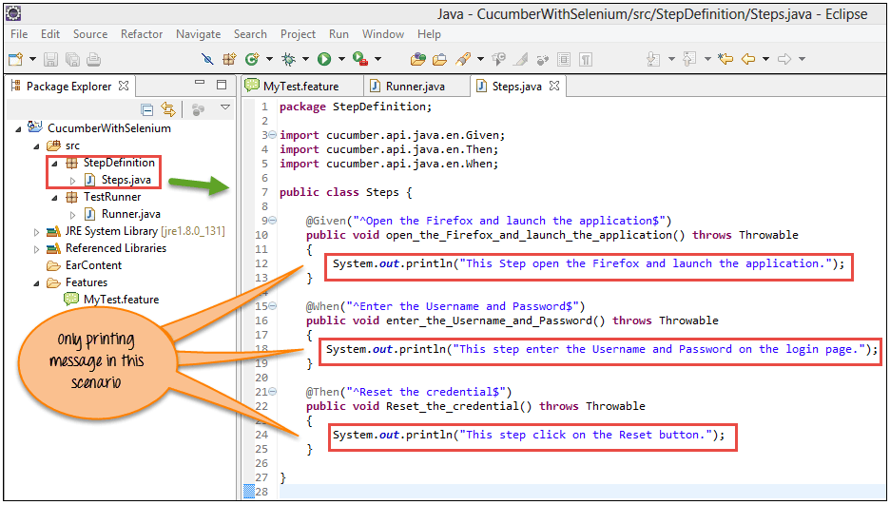
Step 6) Creating Step Definition script.
Here we write a selenium script to carry out the test under Cucumber methods.
@Given annotation define method to open firefox and launch the application
@When annotation define method to enter the username and password
@Then annotation define method to reset the credential

Slide 9
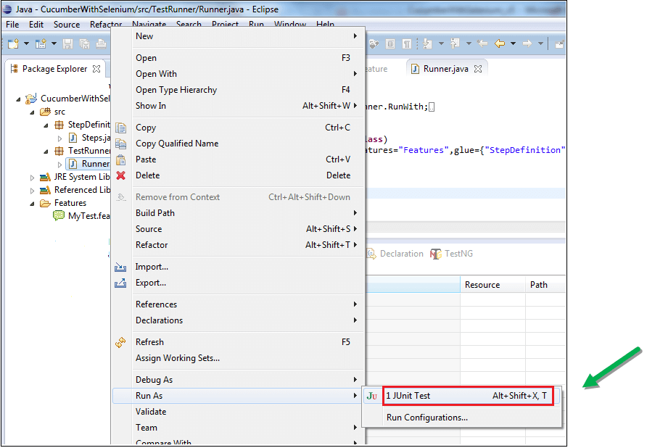
Step 7) Executing the Script.
Here we execute this script from Test runner script, i.e. 'Runner.java' as shown in below screenshot.

Slide 10
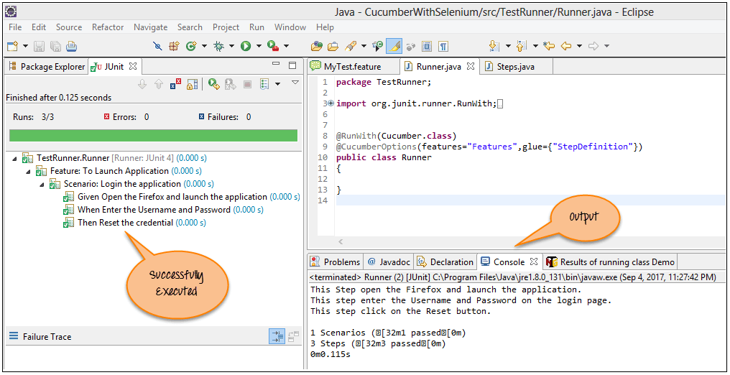
Step 8) Analyze the output.
On executing the 'Runner.java' script, it displays the text on the console. It is the same text defined in 'Steps.java' script.

Slide 11
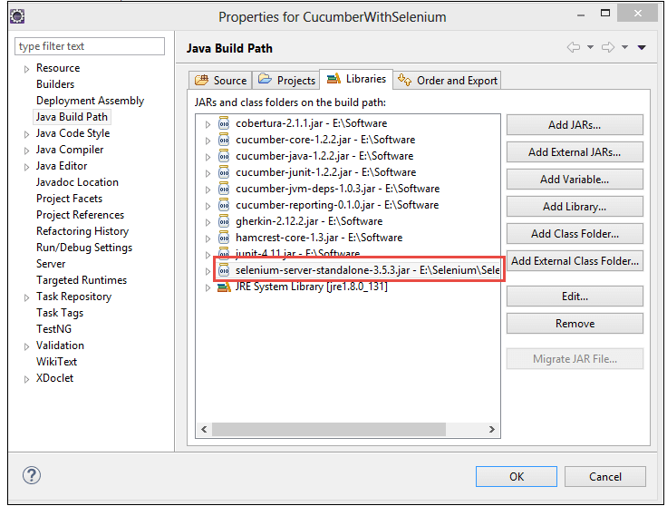
Example 2:- Enter login Credential and reset the value.
Step 1) Add Selenium jar file to this project.

Slide 12
Step 2) Here update the 'Steps.java' script as shown in the below code and screenshot.
package StepDefinition;
import org.openqa.selenium.By;
import org.openqa.selenium.WebDriver;
import org.openqa.selenium.firefox.FirefoxDriver;
import cucumber.api.java.en.Given;
import cucumber.api.java.en.Then;
import cucumber.api.java.en.When;
public class Steps {
WebDriver driver;
@Given("^Open the Firefox and launch the application$")
public void open_the_Firefox_and_launch_the_application() throws Throwable {
System.setProperty("webdriver.firefox.marionette","E://Selenium//Selenium_Jars//geckodriver.exe");
driver= new FirefoxDriver();
driver.manage().window().maximize();
driver.get(“URL"); }
@When("^Enter the Username and Password$")
public void enter_the_Username_and_Password() throws Throwable {
driver.findElement(By.name("uid")).sendKeys("username12");
driver.findElement(By.name("password")).sendKeys("password12"); }
@Then("^Reset the credential$")
public void Reset_the_credential() throws Throwable {
driver.findElement(By.name("btnReset")).click();
} }

Slide 13
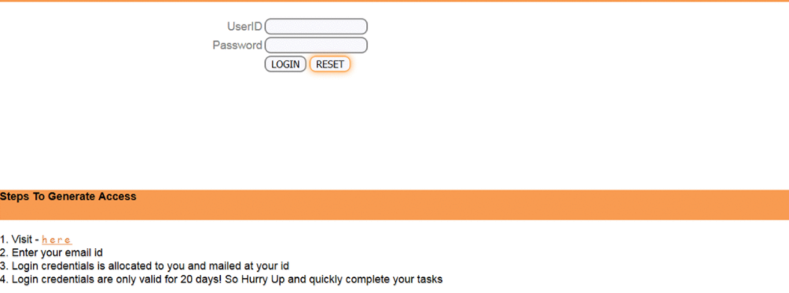
Step 2) Execute the script.
After updating run the Runner.java.
Step 3) Analyze the output

Slide 14
Covered Till Now
Cucumber is a testing approach which supports Behavior Driven Development (BDD). It explains the behavior of the application in a simple English text using Gherkin language.
Cucumber tool is based on the Behavior Driven Development framework that acts as the bridge.
Implementation of cucumber with selenium.

Slide 15
Thanks

